Slide 1
Leverage application roles in custom apps and APIs
Notes:
Application roles are used to assign permissions to users and apps. These roles are defined in the registered Azure AD app’s manifest.

Slide 2

Overview
App roles for custom apps and APIs
Declare roles for an Azure AD app
Utilize app roles in custom web apps
Notes:
In this unit, you’ll learn how to add app roles to an Azure AD registered app, grant users and groups to the role and use the app role within a custom app secured with Microsoft identity.

Slide 3
App roles in custom apps and APIs
Microsoft identity supports Role-Based Access Control (RBAC)
RBAC enables administrators to grant permissions to roles vs individuals or groups
Administrators then assign roles to users and groups to control actions and access
Developers can leverage RBAC in custom apps and APIs
Similar to how security groups work
Notes:
Role-based access control (RBAC) is a popular mechanism to enforce authorization in applications. The administrator can assign roles to different users and groups to control who has access to what content and functionality.
Using RBAC with Application Roles and Role Claims, developers can securely enforce authorization in their apps with little effort on their part.
These application roles are defined in the Azure AD admin center in the application's registration manifest. When a user signs into the application, Azure AD emits a roles claim for each role that the user has been granted individually and from their group membership. Assignment of users and groups to roles can be done through the portal's UI, or programmatically using Microsoft Graph.

Slide 4
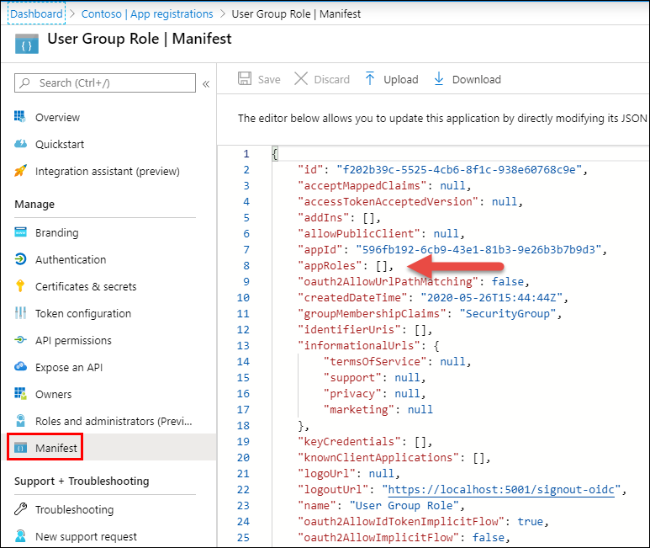
Declare roles for an application
App roles managed within an app in the Azure AD admin center https://aad.portal.azure.com
Must declare app roles within the app’s manifest
Specify roles by adding them to the appRoles array in the app’s manifest
Notes:
App roles can be managed from the Azure AD admin center (https://aad.portal.azure.com). Select an application in the Azure AD admin center. Roles are defined in the app's manifest that is accessible from the **Manifest** navigation item.
Locate the `appRoles` setting in the manifest:

Slide 5
Declare roles for an application
"appRoles": [{
"allowedMemberTypes": [ "User" ],
"description": "Administrator role for Product Catalog web application.",
"displayName": "ProductAdministrators",
"id": "98ce9517-557f-4ac5-b827-f18d948ee552",
"isEnabled": true, "lang": null, "origin": "Application",
"value": "ProductAdministrators"
}, {
"allowedMemberTypes": [ "User" ],
"description": "Viewer role for Product Catalog web application",
"displayName": "ProductViewers",
"id": "7465fed6-02cc-467c-87c2-fa6e0bf4f929",
"isEnabled": true, "lang": null, "origin": "Application",
"value": "ProductViewers"
}]
Notes:
Add application roles to the manifest by adding them to this `appRoles` property. For example, the following JSON defines two new roles: **ProductAdministrators** and **ProductViewers**.
The `displayName` property can't contain any spaces.

Slide 6
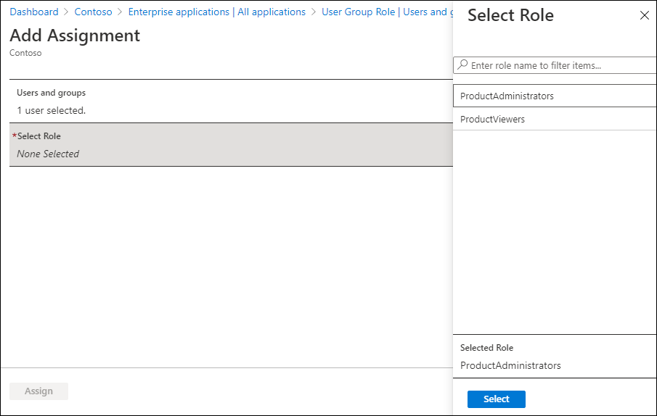
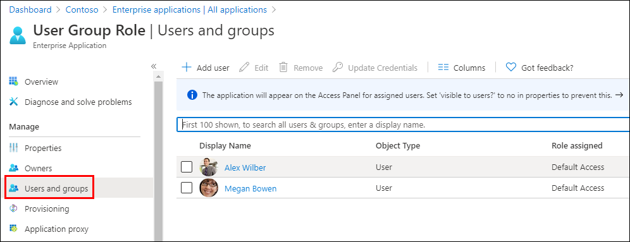
Assign roles to users and groups
Select the Azure AD app from the “Enterprise Applications” menu
Select the “Users & Groups” menu to assign app roles to users
Select users & groups
Select app roles defined in manifest to assign the role to users
Notes:
After defining the app roles within the app's manifest, you can now add users to the role.
From the **Enterprise application** blade in the Azure AD admin center, select the application and then select the **Users & Groups** navigation item.
Select **Add User**. On the **Add Assignment** blade, select the users or groups you want to add to the app role. Then select the app role or app roles to add the user or groups.

Slide 7
Utilize app roles in custom web apps
Similar code configuration process as security groups
JwtSecurityTokenHandler.DefaultMapInboundClaims = false;
services.Configure<OpenIdConnectOptions>(
AzureADDefaults.OpenIdScheme,
options => {
options.Authority = options.Authority + "/v2.0/";
options.TokenValidationParameters.NameClaimType = "preferred_username";
options.TokenValidationParameters.RoleClaimType = "roles";
}
);
Notes:
Using app roles as the authorization source is similar to using the group claims in a previous exercise. There are two changes from using groups:
1. Turn off the ASP.NET claim type mapping (since we aren't supporting legacy applications).
1. Use the roles claims in the token as the `RoleClaimType`.
With the app registered and configured in the Azure AD admin center, the next step is to update the app's configuration.
In an ASP.NET web app, within the `ConfigureServices()` method in the **Startup.cs** file, update the configuration of the `OpenIdConnectOptions` when configuring the service to the following. This code will first disable the default mapping of claims and configure OpenIDConnect to map the roles to the app roles.
Notice the difference in the line for the `RoleClaimType` is set to `roles`. This is added to specify the claim that represents app roles when creating the ClaimsPrincipal in ASP.NET.

Slide 8
Securing controllers and methods with app roles
[Authorize(Roles=("ProductViewers,ProductAdministrators"))]
public class ProductsController : Controller { }
[Authorize(Roles = ("ProductAdministrators"))]
public ActionResult Create() {
var viewModel = new ProductViewModel() { Categories = data.Categories };
return View(viewModel);
}
[HttpPost]
[Authorize(Roles = ("ProductAdministrators"))]
public ActionResult Create([Bind("ProductName", "CategoryId")] ProductViewModel model) {
data.Products.Add(new Product() {
Id = data.Products.Max(p => p.Id) + 1, Name = model.ProductName,
Category = new Category { Id = model.CategoryId }
});
return RedirectToAction("Index");
}
Notes:
In ASP.NET, you can secure a controller so only authenticated users can access it by decorating it the method with the `[Authorize]` attribute. This attribute also supports securing the endpoint based on an app role.
After configuring the OpenID Connect middleware to use Microsoft identity as the role claim, you can specify the ID of a group to secure the controller.
You can also use the `[Authorize]` attribute to secure specific methods on the endpoint. For example, the following code will only allow **ProductAdministrators** the ability to create new products on the `ProductsController`.

Slide 9
Demo

Slide 10
Thank you.

